Slide 1
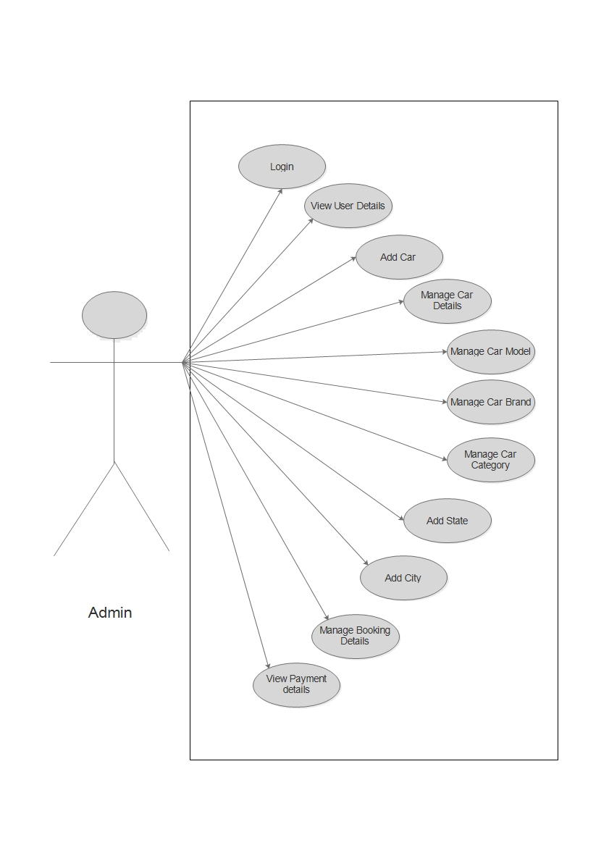
Admin Side Use Case Diagram

Slide 2
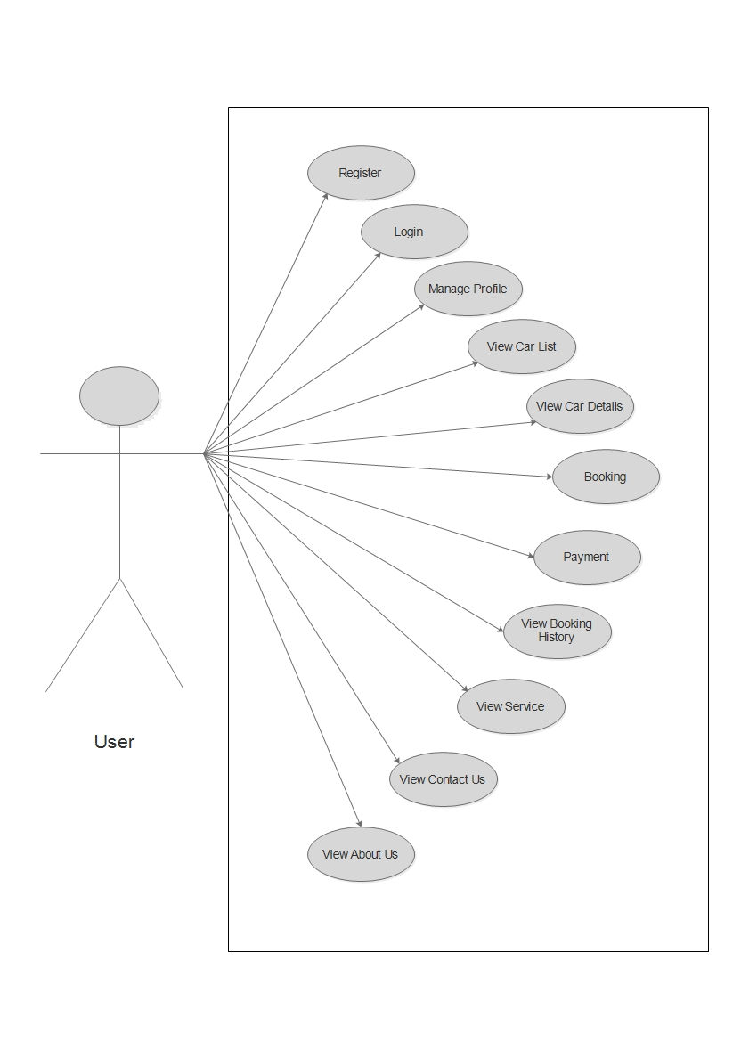
Client Side Use Case Diagram

